Slide 1
Big Data
By: Jediniah Womack

Slide 2
What was Done in Ctec 298
Github
Jupyter Notebook
Dataquest
Matplotlib Python
Visualizations/Plots

Slide 3
What is Big data
It is to analyze and extract information from or deal with data sets that are too large or complex to be dealt with by traditional data-processing application software.

Slide 4
DataQuest
Python is an interpreted, object-oriented, high-level programming language with dynamic semantics.
Convert int -> float, float(10) -> 10.0
Convert float -> int, int(4.3) -> 4
Lists ex. -> Row_1 = ['Football, 0.5, USD, 355, 1.5]

Slide 5
Read & Write CSV file
CSV(Comma Separated File)- It is a plain text file that uses specific structuring to arrange tabular data.
They come from large parts of data; they are a convenient way to export data from spreadsheets and databases as well as import and use it in other programs.
The CSV library provides functionality both to read and write to CSV files.

Slide 6
How to Read, Write & use headers in CSV
Import pandas as pd
Df = pd.read.csv(“stack_data.csv”)
Df.to_csv(“stack_data.csv”)
Df = pd.read.csv(“stack_data.csv”, skiprows = 1)
Df = pd.read.csv(“stack_data.csv”, header = 1)
Df = pd.read.csv(“stack_data.csv”, header = none)

Slide 7
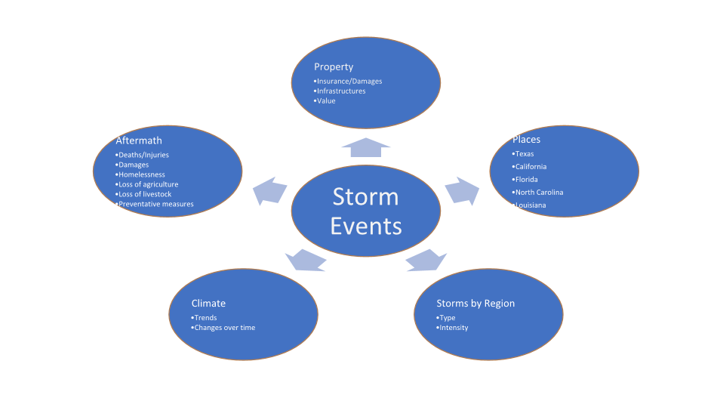

Slide 8
Storm Events Data
We got our data from the NOAA data set.
https://www.ncdc.noaa.gov/stormevents/

Slide 9
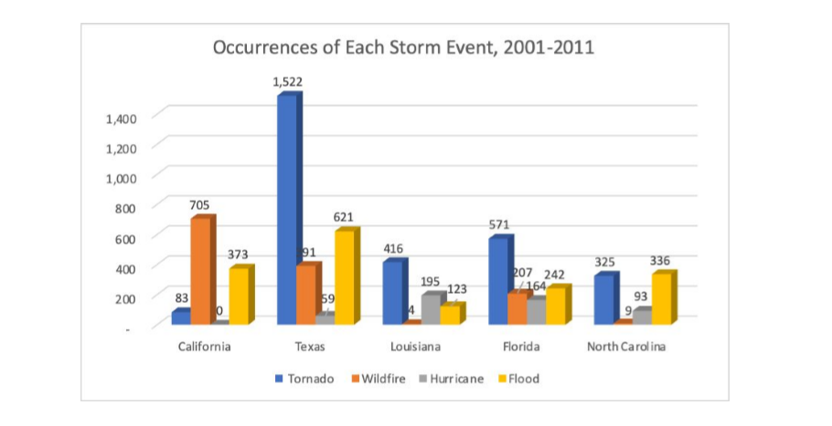

Slide 10
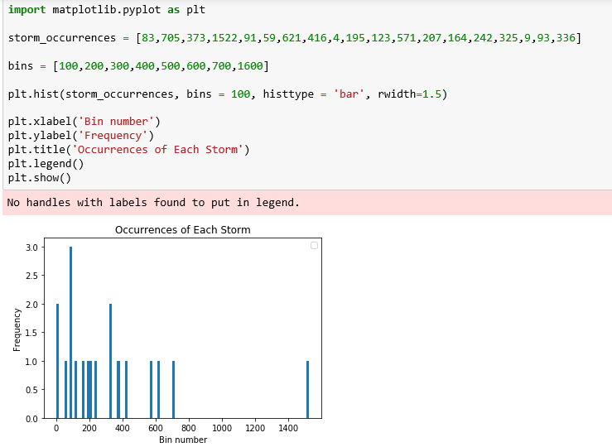
Histogram

Slide 11
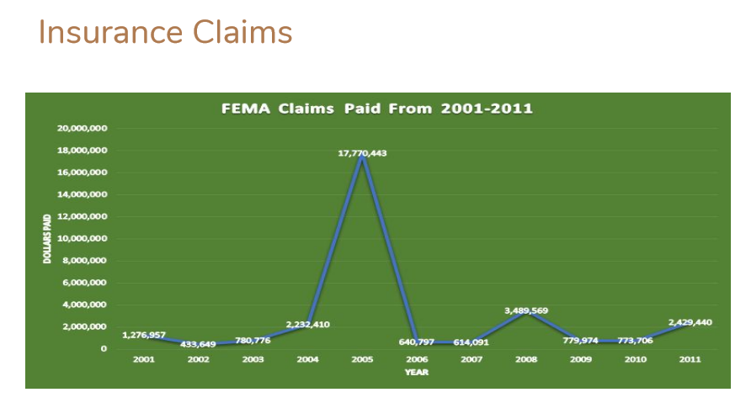

Slide 12
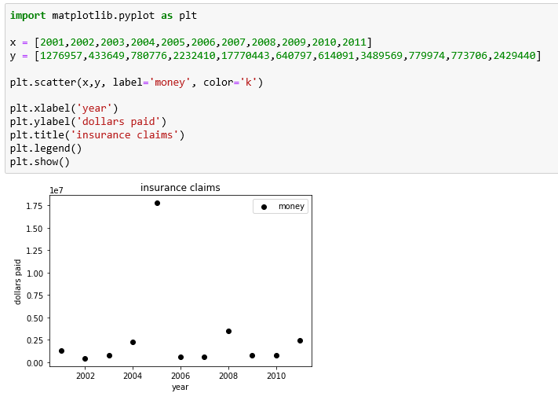
Scatter Plot

Slide 13
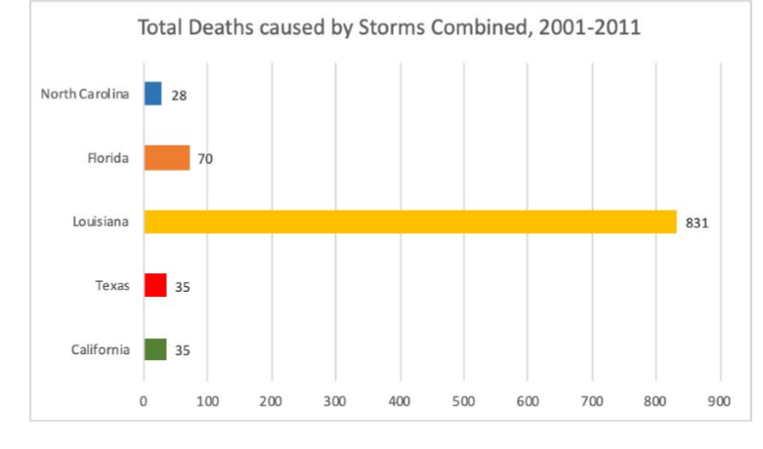

Slide 14
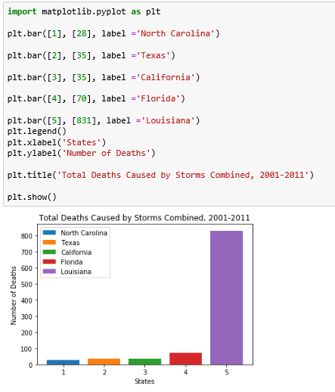
Bar plot

Slide 15
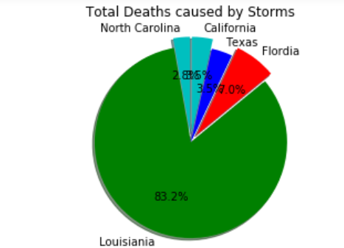
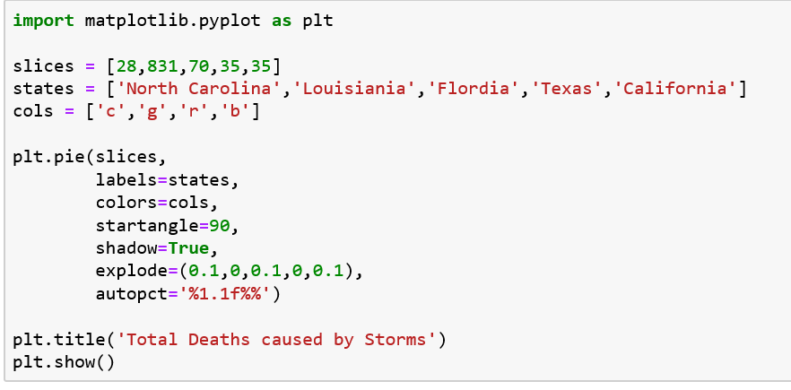
Pie Plot
2.85

Slide 16
References
https://www.ncdc.noaa.gov/stormevents/
https://www.youtube.com/watch?v=-0NwrcZOKhQ

Slide 17
Questions

